Slide 1


Introduction
OCE2901 – Surf Engineering Analysis
OCE5903 – Ocean Engineering Data Analysis

Slide 2

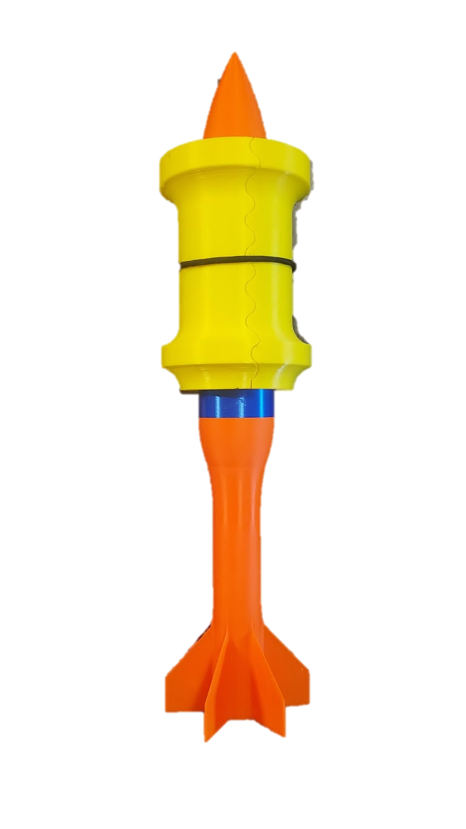
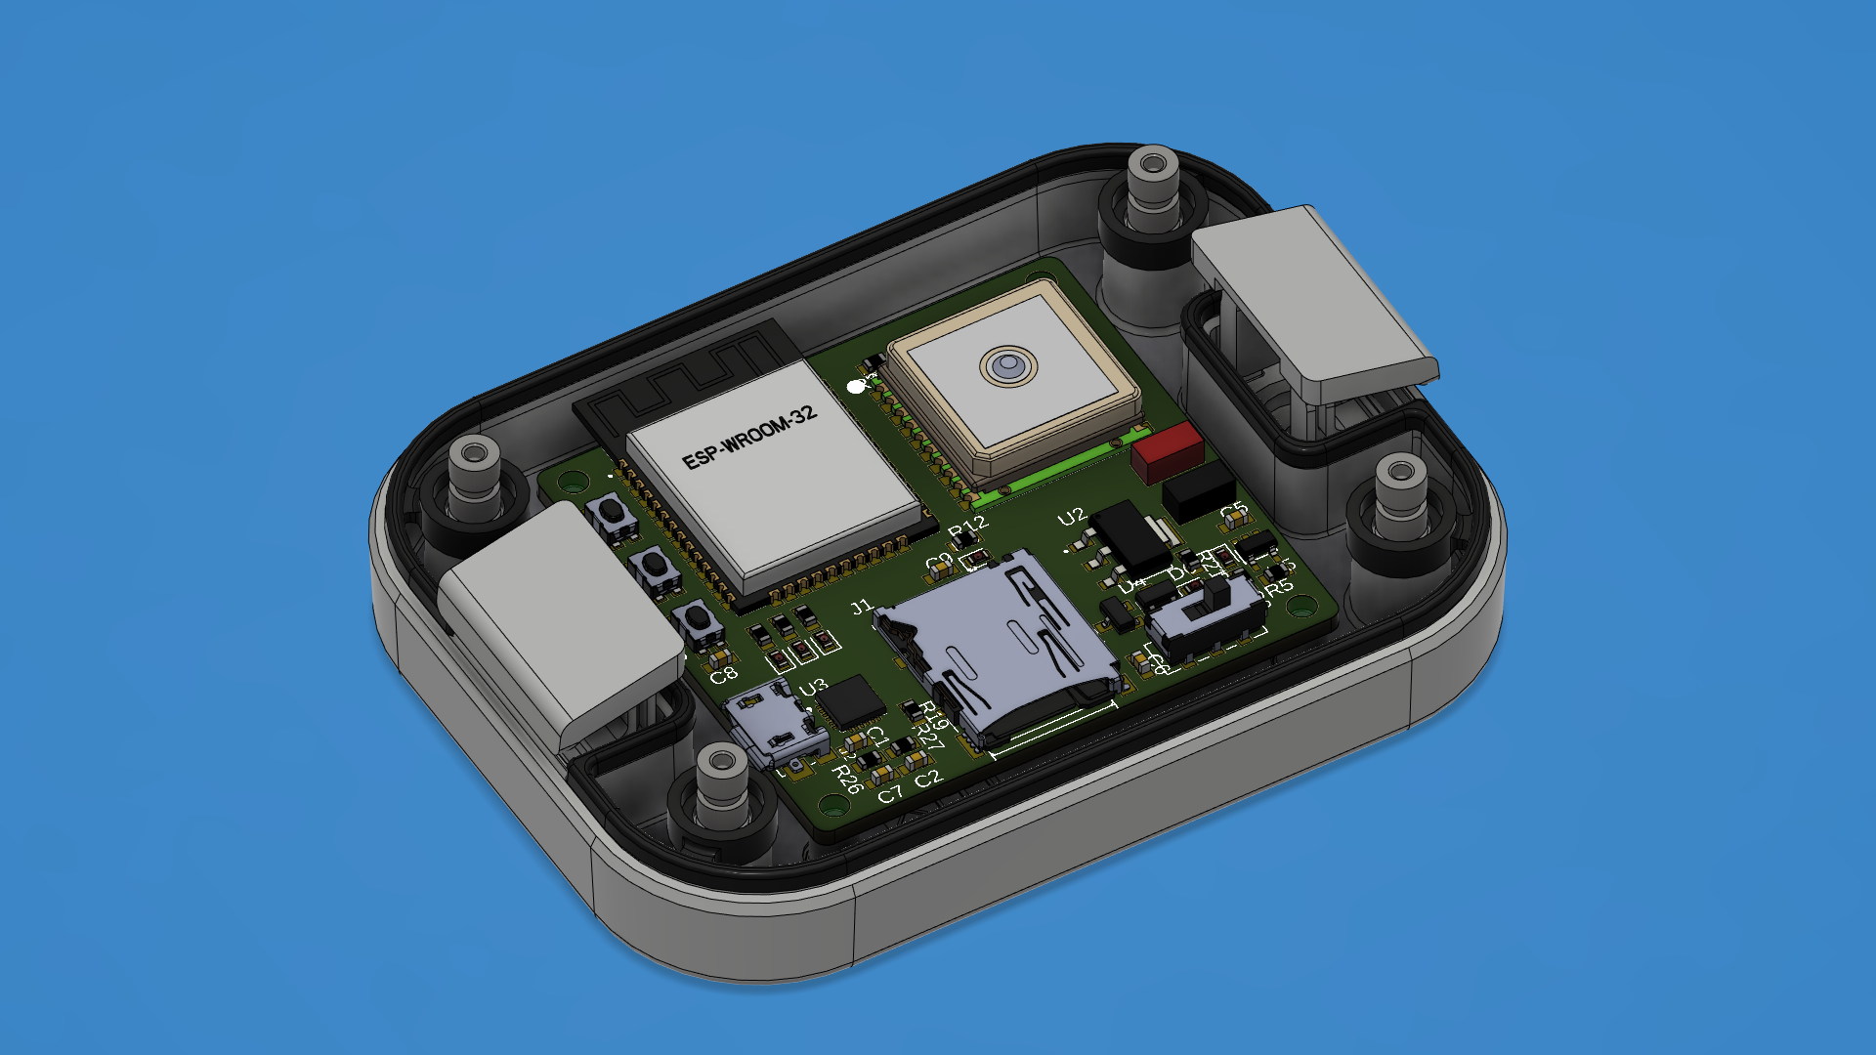

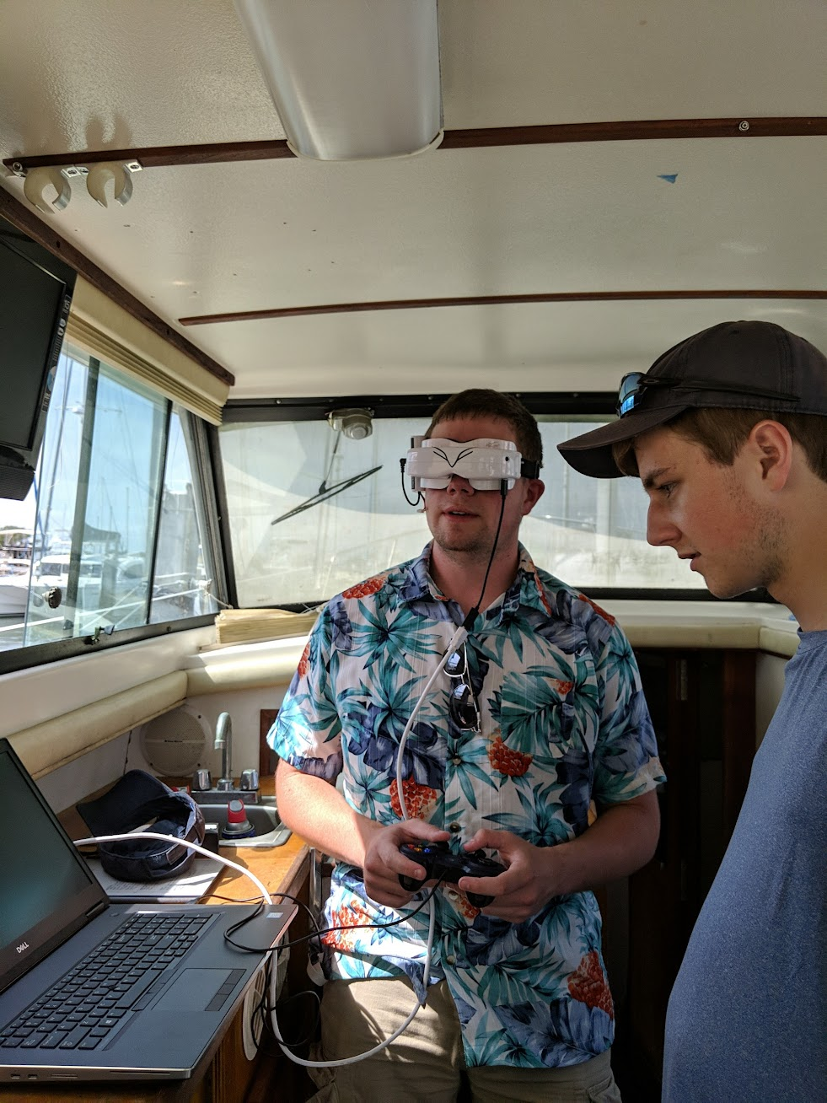
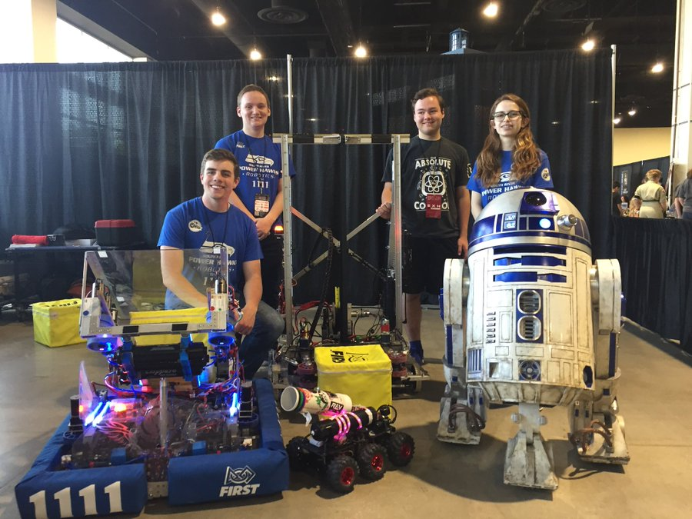
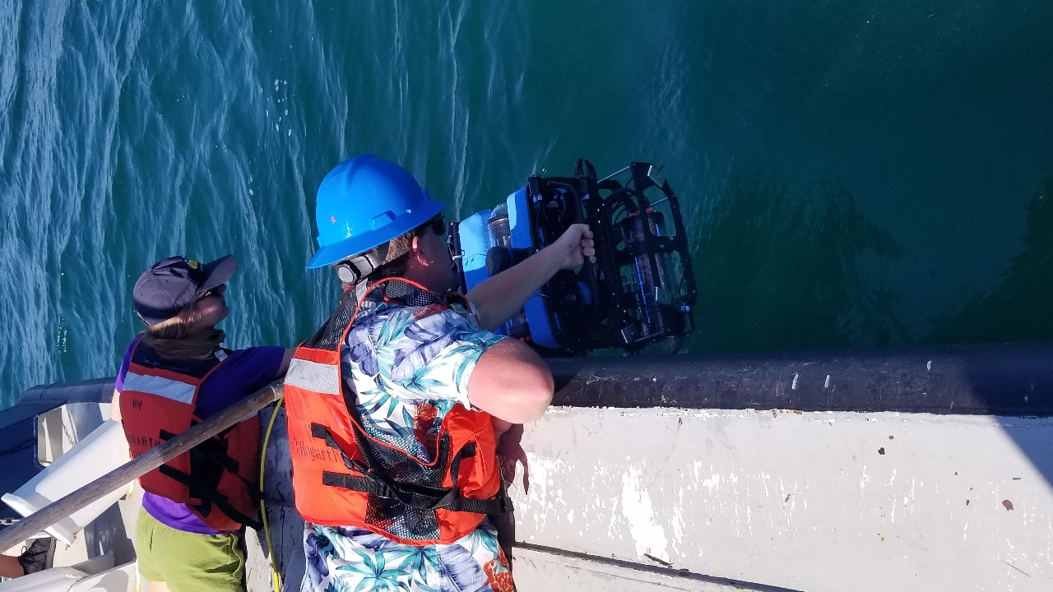
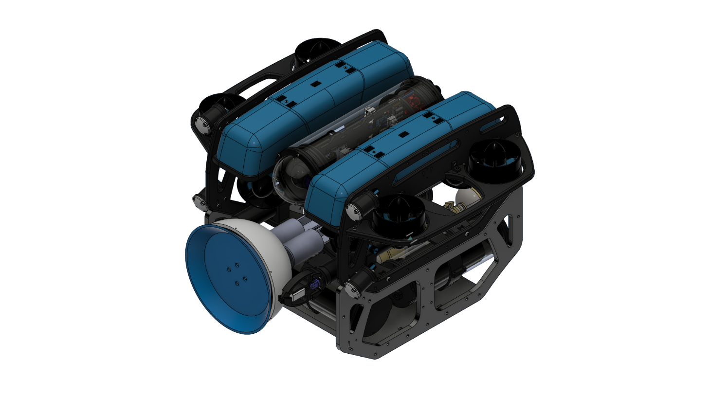
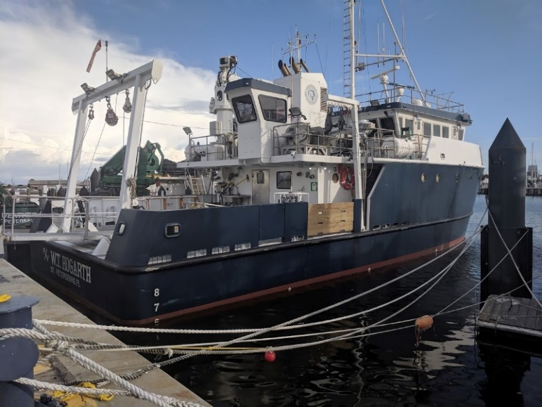
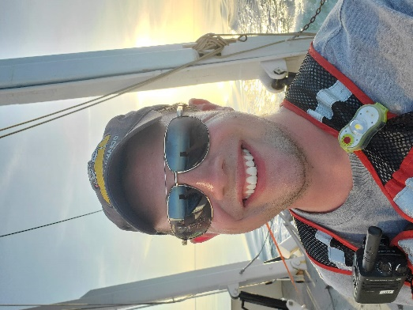
About Me

Slide 3
Syllabus Overview
Attendance is mandatory*
Work as a team on a research question
Multiple homework assignments
Supplemental readings will be available, but not required
Using reference material is highly encouraged to accomplish the project
Extensive use of programming, however, the fundamentals will not be taught here
Multiple reports and presentations throughout the semester
Course Outcomes:
Provide students with the experience needed to solve engineering problems through direct measurement by learning instrument deployment, data collections, and analysis techniques.
Teach students how to design a field experiment given available, recordable data, and a research question
Teach students how to draw conclusions from relationships present in the field data they analyze
*only during field deployments

Slide 4
Syllabus Overview
Score | Grade | Quality Points
90-100 | A | 4
80-89 | B | 3
70-79 | C | 2
Lower* | Please Don’t | Seriously
*Graduate students fail the course

Slide 5

Important Dates
NO CLASS – 01/16
Last day to drop without a “W” – 01/18
Field Experiment Dry Run in Coastal Lab - 02/03
Group 1 Wet Run in Waves Lab – 02/10
Group 2 Wet Run in Waves Lab – 02/17
Start field deployments – week of 02/20
SPRING BREAK – week of 03/13
Last day to drop with a “W” – 03/24
Midterm due – 03/24
Final Report due – 04/26
Final Presentation (oral) - 05/05

Slide 6
Assignment Schedule
Assignment | Due Date
Homework 1: Variables and Sensors List | January 11
Homework 2: Research Topic Quad Chart | January 16
Homework 3: Dice Roll Assignment | January 20
Literature Review Quad Chart* | January 27
Field Experiment Procedure | February 03
Homework 4: Data Plotting | February 10
Experiment Schedule | February 20
Homework 5: Wave Analysis | March 10
Latest Experimental Procedure Draft | >24 Hours Before Deployment
Risk Management Assessments | During Deployments
Deployment Checklist | After Deployments
Midterm | March 24
Final Report | April 26
Final (Oral Presentation) | May 05

Slide 7
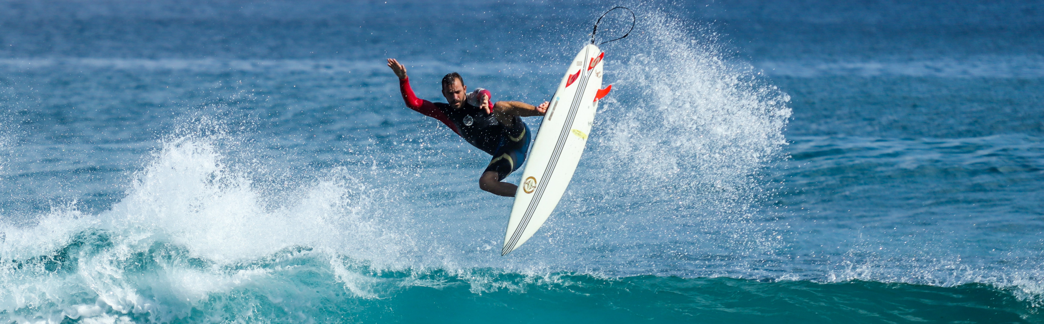
Field Experiments
What to expect for

Slide 8
Field Experiments
Every week starting February 20, groups will go out to the field to collect data
Groups will alternate which one is in the field every week
You will be creating a schedule soon that includes primary and secondary and tertiary testing days considering:
The time of ideal surf conditions (ie. Low tide, offshore winds, 2-3 feet waves)
The time all group members can meet
The time when the instructor(s) can meet
The time any external surfers (e.g. students from the surf club) can meet

Slide 9

Before the Field Experiments
At least 24 hours before the experiment, the PI will send me the latest version of your procedure to review
Highlight any changes from the previous version and note team member contributions on a separate document
If procedure is denied, the group must rework it based on feedback and have it approved before you can go out

Slide 10
During the Field Experiments
Safety, safety, safety, safety
Principal Investigator and Safety Coordinator will hold a team briefing
The PI shall inform team members about their individual roles and responsibilities for the deployment
The SC will conduct a safety review using a Risk Management Assessment (RMA)
If the RMA is too high, or the conditions are deemed unsafe, the SC has the ultimate responsibility to call off the experiment

Slide 11

After the Field Experiments
Create a detailed deployment report
Due two weeks after the deployment occurs
All team members should be responsible for, and contribute to, a portion of the report
Include contributions in a separate document
(Think lab report format from previous courses)
Executive Summary, Introduction, Methods, Analysis, Discussion, Conclusions

Slide 12
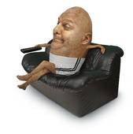
Failure to Perform Duties
If group members fail to do their assigned tasks as determined by the PI, the PI has the responsibility to determine why, and address it, if necessary,
If the neglect is chronic, the PI is expected to talk to me about it so I can determine the best course of action
Penalties for missing sections or content will be counted towards the entire team barring extraordinary circumstances
This Photo by Unknown Author is licensed under CC BY-NC-ND

Slide 13

Let’s Talk About Teams

Slide 14
Team Definition
EX: How can we relate the surfer motion to the wave dynamics using three unique non-dimensional parameters?
Team Assignment
Research Questions
Hopefully, you have filled out the form to choose your own group!
Whoever doesn’t have it filled out will be randomly assigned to a group
Each group can choose their own research question. Must conform to the following:
Be related to surfing and wave dynamics
Be quantifiably answered using currently-available tools
Be deep enough to facilitate a semester’s research
Be quantifiably answered using currently-available techniques

Slide 15
Executive Role Definitions
Principal Investigator (PI)
Technician
Safety Coordinator (SC)
Responsible for the team organization, submissions, delegations, and broad research objectives
Must be a graduate student
Responsible for the proper care and maintenance of the equipment
Responsible for transportation, deployment, and recovery
Responsible for training members on operation (hint: this will be very important for the midterm…)
Responsible for team safety during deployments
Responsible for caring for, maintaining, stocking and carrying the team’s first aid kit
Leads the RMA before the start of every deployment
Cannot be a surfer
Responsible for team coordination, training, and mentoring members
Graduate students must take on these executive roles unless there are none available

Slide 16
Team Hierarchy
Principal Investigator
Technician
Research Assistant
Research Assistant
Research Assistant
Safety Coordinator
Research Assistant

Slide 17
Miscellaneous Policies
Late work
Accommodations
Academic Dishonesty
Course evaluations
Remote Learning
Accepted up to five (5) days after assignment due date. -10% for every 24 hours starting 1 minute after the assignment due date.
Possible, please let me know ahead of time if you plan to attend remotely. I will try to post lectures in a timely manner, no guarantees though
Consult Florida Tech policies. I will try my best to help, within reason
I take this seriously. Only considered on official submissions, consult with me if you have doubts.
An extra 2 points to everyone’s grade overall, if and only if, there is a 100% response rate.

Slide 18
Don’t be a d***.
Wheaton’s Law
Title IX

Slide 19

Group Discussion
Get in your research groups!
Notes:
Allow students to mingle in their teams, make introductions, discuss interests, ideas, etc.
Finish at 10 minutes to end of class.

Slide 20

IS TO INDIVIDUALLY BRAINSTORM VARIABLES YOU MIGHT NEED TO MEASURE AND THE SENSORS REQUIRED TO DO SO
Due: Wednesday, January 11, 2022
Notes:
Get to this slide with 10 minutes to spare in class
Details will be posted on CANVAS.
Project groups that do NOT have an idea of what they are doing for a project have until Friday to produce a project idea
Consultation with GSAs and professors is *highly* encouraged to determine relevance and feasibility
Groups will create a quad chart that will be electronically submitted via CANVAS that outlines their project idea
The quad chart must include the following: Project title and brief overview, purpose, feasibility, and relevance (to ocean engineering and society)
The quad chart will be presented to the class either hard-copy on posterboard, or electronically via projector. A quick questions period will be open to the class after the presentation

Slide 21
ADDITIONALLY
AS A GROUP, BRAINSTORM A POTENTIAL RESEARCH TOPIC. CREATE A QUAD CHART TO EXPLAIN
Due: Monday, January 16, 2022
Notes:
Get to this slide with 10 minutes to spare in class
Details will be posted on CANVAS.
Project groups that do NOT have an idea of what they are doing for a project have until Friday to produce a project idea
Consultation with GSAs and professors is *highly* encouraged to determine relevance and feasibility
Groups will create a quad chart that will be electronically submitted via CANVAS that outlines their project idea
The quad chart must include the following: Project title and brief overview, purpose, feasibility, and relevance (to ocean engineering and society)
The quad chart will be presented to the class either hard-copy on posterboard, or electronically via projector. A quick questions period will be open to the class after the presentation

Slide 22

Questions?
Braidan Duffy
Email: bduffy2018@fit.edu
Office phone: 303-709-4048
Office hours: MWF 11-1200
Office location: Link 156

